Slide 1
Chapter 5
语法制导翻译

Slide 2
语法制导定义
语法制导定义是一个带有属性规则的文法:
  属性.
  语义规则
属性分为继承属性与综合属性.
语义规则是对于一个产生式 A → α:
  b = f (c₁,…,c_{n}) where
  (b 是综合属性) b 是A的一个属性 并且 c₁…c_{n} 是 α中的文法符号的属性.
  (b 是继承属性) b 是α中某个文法符号的属性 并且 c₁…c_{n} 是 A或α中的文法符号的属性.
Notes:
shangsheng

Slide 3
    语法制导定义将属性值的计算次序隐藏在语义规则中。

Slide 4
终结符只有综合属性，且属性值来自词法分析器.
开始符号没有继承属性.
在语法分析时，当调用某条产生式时，可以计算该产生式对应的语义规则.
产生式 语义规则
L → E n print(E.val)
E → E₁ + T E.val = E₁.val + T.val
E → T E.val = T.val
T → T₁ * F T.val = T₁.val * F.val
T → F T.val = F.val
F → (E) F.val = E.val
F → digit F.val = digit .lexval
Example 3*5+4n

Slide 5
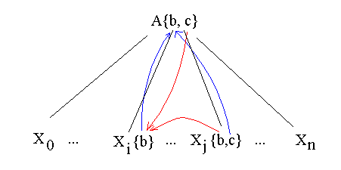
综合属性
每个文法符号 X∈∑ 均有一个属性集合
Attrib(X)={X.a₁, Xa₂,…X.a_{m}}
每条产生式规则: A→α 均可以有形如 b=f(c₁,…,c_{n})的语义规则集合，其中 c_{i} ∈Attrib(Aα)
b∈Attrib(A): 综合属性 (从儿子结点的属性值计算得来 ）A.b=X_{i}.b+X_{j}.c
b∈Attrib(α): 继承属性 (由父亲结点或兄弟结点的属性值计算得来) X_{j}.b = conc(A.c, X_{i}.b)

Slide 6
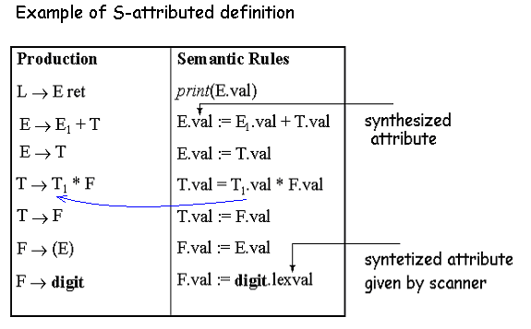
S属性定义
语义规则里只出现综合属性，这样的语法制导定义称为S属性定义.

Slide 7
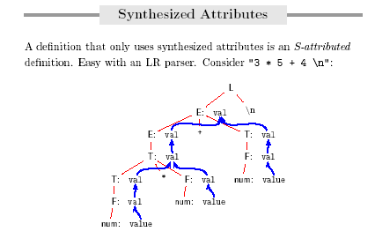

Slide 8
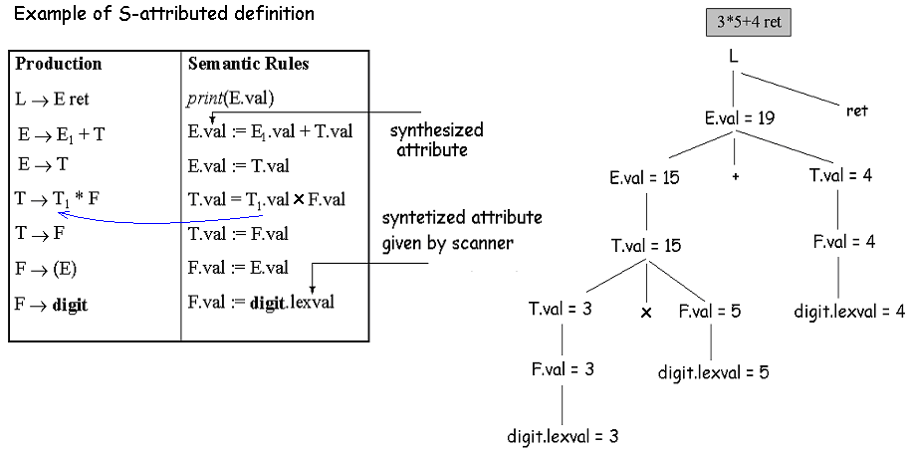
注释分析树 (5.2):

Slide 9
继承属性
PRODUCTION SEMANTIC RULE
D → T L L.in = T.type
T → int T.type = integer
T → real T.type = real
L → L₁ , id L₁.in = L.in
addtype(id.entry, L.in)
L → id addtype(id.entry, L.in)
Example real id₁, id₂ , id₃

Slide 10
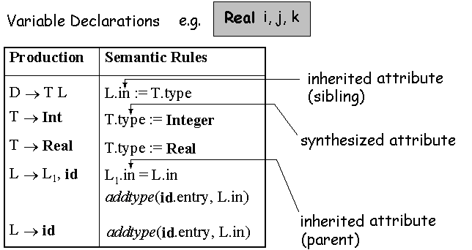
Example.
过程 addtype(…) 指将类型信息加入符号表

Slide 11
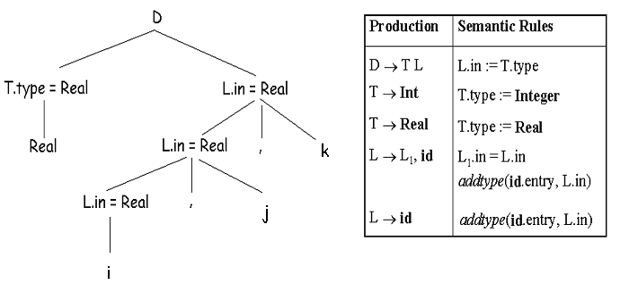

Slide 12
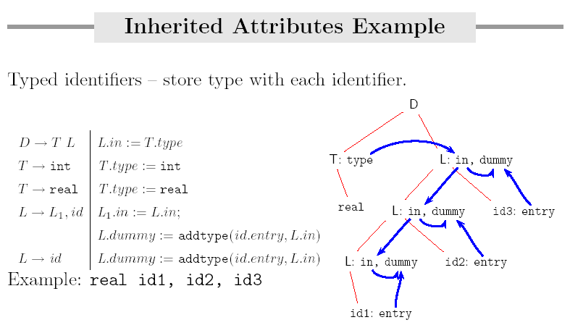

Slide 13
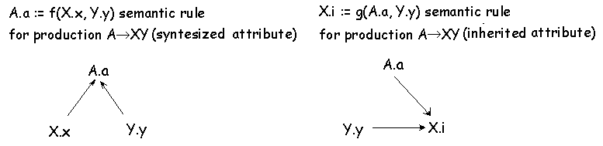
依赖图

Slide 14
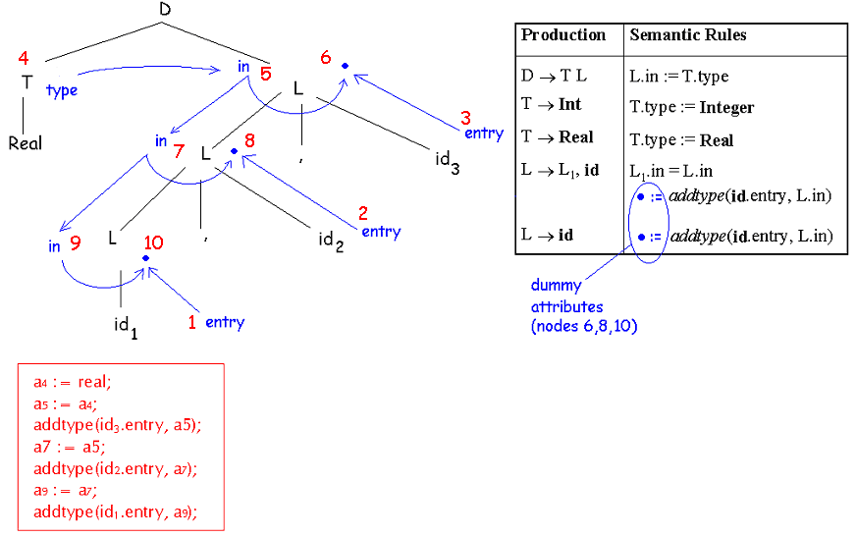

Slide 15
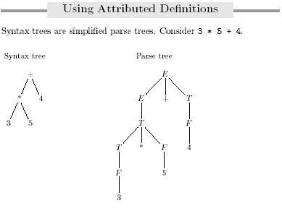

Slide 16
assignment statement
Figure Parse tree
:=
identifier
expression
+
position
expression
expression
*
identifier
expression
expression
initial
identifier
number
:=
rate
60
position
+
initial
*
Figure Syntax tree
rate
60

Slide 17
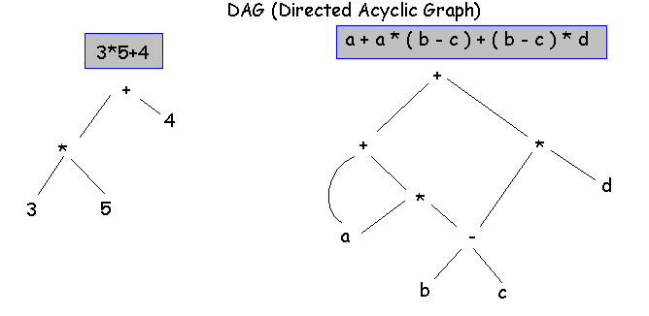

Slide 18
PRODUCTION SEMANTIC RULE
E → E₁ + T E.nptr = mknode(“+”,E₁.nptr ,T.nptr)
E → E₁ - T E.nptr = mknode(“-”,E₁.nptr ,T.nptr)
E → T E.nptr = T.nptr
T → (E) T.nptr = E.nptr
T → id T.nptr = mkleaf(id, id.lexval)
T → num T.nptr = mkleaf(num, num.val)
Example: a-4+c

Slide 19
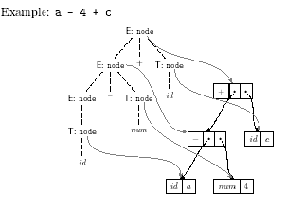

Slide 20
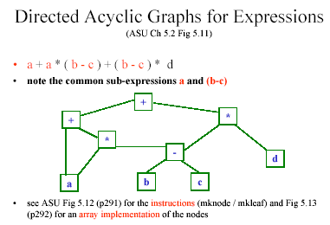

Slide 21
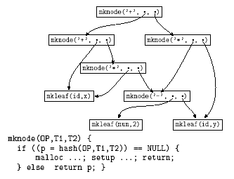

Slide 22
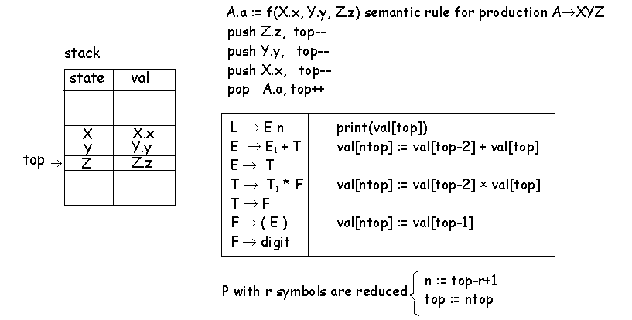
S属性定义的自底向上翻译

Slide 23
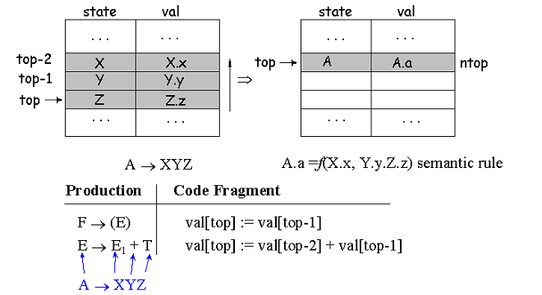

Slide 24
Example
PRODUCTION SEMANTIC RULE
L → E n print(E.val)
E → E₁ + T E.val = E₁.val + T.val
E → T E.val = T.val
T → T₁ * F T.val = T₁.val * F.val
T → F T.val = F.val
F → (E) F.val = E.val
F → digit F.val = digit .lexval
PRODUCTION CODE FRAGMENTt
L → E n print(val[top])
E → E₁ + T val[ntop] = val[top-2]+val[top]
E → T
T → T₁ * F val[ntop] = val[top-2]*val[top]
T → F
F → (E) val[ntop] = val[top-1]
F → digit
Example:
3*5+4n

Slide 25
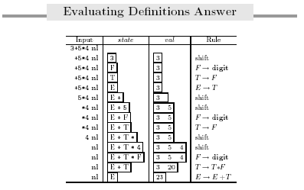

Slide 26
L属性定义
  A→ X₁…X_{n}
  X_{j} 的一个继承属性依赖于
    X₁…X_{j-1} 的属性（继承属性或综合属性）
    A的继承属性
所有的S属性定义是L属性定义.

Slide 27
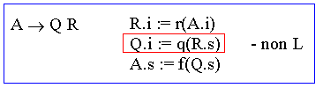
Example
不是L属性定义的例子
PRODUCTION SEMANTIC RULE
A → LM L.i = f₁(A.i)
M.i = f₂(L.s)
A.s = f₃(M.s)
A → QR R.i = f₄(A.i)
Q.i = f₅(R.s)
A.s = f₆(Q.s)

Slide 28
翻译模式
将语义规则嵌入到产生式的规则里.
Example.
expr → expr + term { print(“+”) }
expr → expr - term { print(“-”) }
expr → term
term → 0 { print(“0”) }
…
term → 9 { print(“9”) }

Slide 29
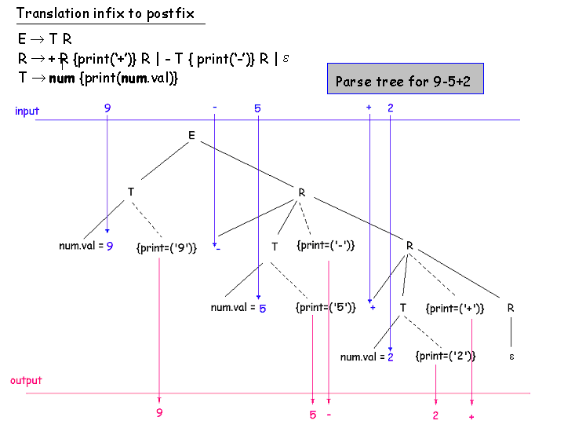

Slide 30
Examples
S → A₁ {S.s = A₁.s+A₂.s} A₂
A→ a {A.s = 1}
This will not work…
On the other hand this is good:
S → A₁ A₂ {S.s = A₁.s+A₂.s}
A→ a {A.s = 1}

Slide 31
Examples II
S → A₁ A₂ {A₁.in = 1; A₂.in = 2}
A→ a {print(A.in)}
This will not work…
On the other hand this is good:
S → {A₁.in = 1; A₂.in = 2} A₁ A₂
A→ a {print(A.in)}
Or even:
S → {A₁.in = 1} A₁ {A₂.in = 2} A₂
A→ a {print(A.in)}

Slide 32
例子
数学公式排版语言
S → B
B → B B
B → B sub B
B → text
“sub”表示下标 .

Slide 33
产生式 语义规则
S→ B B.ps = 10; S.ht = B.ht
B → B₁ B₂ B₁.ps = B.ps; B₂.ps = B.ps;
B.ht = max(B₁.ht, B₂.ht)
B → B₁ sub B₂ B₁.ps = B.ps; B₂.ps = shrink(B.ps);
B.ht = disp(B₁.ht, B₂.ht)
B → text B₁.ht = text.h * B.ps
翻译模式
S→ {B.ps = 10} B { S.ht = B.ht }
B → {B₁.ps = B.ps} B₁ {B₂.ps = B.ps } B₂ {B.ht = max(B₁.ht, B₂.ht) }
B → {B₁.ps = B.ps} B₁ sub {B₂.ps = shrink(B.ps)} B₂ {B.ht = disp(B₁.ht, B₂.ht)}
B → text {B₁.ht = text.h * B.ps }

Slide 34
自顶向下翻译（实现L属性定义）
回顾第四章的文法规则：
E → TE’ E’ → + TE’ | ∈
T → FT’ T’ → * FT’ | ∈
F → ( E ) | id

Slide 35
main()
{
E();
}
E’()
{
if lookahead = ‘+’ then
{ match(‘+’); T(); E’(); }
}
TE()
{
T();
E’();
}
F()
{
if lookahead = ‘(’ then
{ match(‘(‘); E(); match(‘)’); }
else
...
}
T()
{
F();
T’();
}
E’()
{
if lookahead = ‘*’ then
{ match(‘*’); F(); T’(); }
}

Slide 36
翻译模式
E→ E₁ + T {E.val = E₁.val + T.val}
E→ E₁ - T {E.val = E₁.val - T.val}
E→ T {E.val = T.val}
T→ (E) {T.val = E.val}
T → num {T.val = text.val }
消除左递归以后:
E→ T {R.i = T.val} R {E.val = R.s }
R→ + T {R₁.i = R.i + T.val} R₁ {R.s = R₁.s}
R→ - T {R₁.i = R.i - T.val} R₁ {R.s = R₁.s}
R → ε {R.s = R.i}
T→ (E) {T.val = E.val}
T → num {T.val = text.val }
Example:
9-5+2

Slide 37
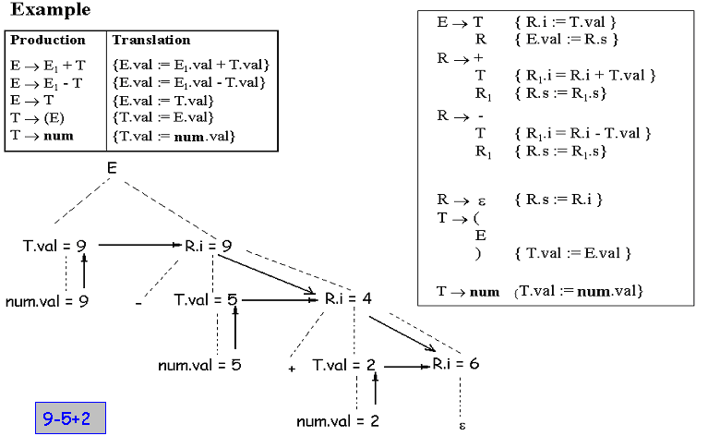

Slide 38
总结:
A→ A₁ Y {A.a = g(A₁.a , Y.y) }
A→ X {A.a = f(X.x) }
转换为:
A→ X {R.i = f(X.x)} R {A.a = R.s) }
R→ Y {R₁.i = g(R.i, Y.y)} R₁ {R.s = R₁.s ) }
R → ε{R.s = R.i}
Example:
XYY

Slide 39
E→ E₁ + T {E.nptr = mknode(“+”, E₁.nptr , T.nptr )}
E→ E₁ - T {E.nptr = mknode(“-”, E₁.nptr , T.nptr )}
E→ T {E.nptr = T.nptr }
T→ (E) {T.nptr = E.nptr}
T→ id {T.nptr = mkleaf(id, id.entry)}
T→ num {T.nptr = mkleaf(num, num.entry)}
Translation Scheme with left recursion removed:
E→ T { ??? } R { ??? }
R→ + T { ??? } R₁ { ??? }
R→ - T { ??? } R₁ { ??? }
R → ε {R.s = R.i}
T→ (E) {T.nptr = E.nptr}
T→ id {T.nptr = mkleaf(id, id.entry)}
T→ num {T.nptr = mkleaf(num, num.entry)}

Slide 40
E→ E₁ + T {E.nptr = mknode(“+”, E₁.nptr , T.nptr )}
E→ E₁ - T {E.nptr = mknode(“-”, E₁.nptr , T.nptr )}
E→ T {E.nptr = T.nptr }
T→ (E) {T.nptr = E.nptr}
T→ id {T.nptr = mkleaf(id, id.entry)}
T→ num {T.nptr = mkleaf(num, num.entry)}
Translation Scheme with left recursion removed:
E→ T { R.i = T.nptr } R { E.nptr =R.s}
R→ + T { R₁.i = mknode(“+”, R.i , T.nptr )} R₁ { R.s = R₁.s }
R→ - T { R₁.i = mknode(“-”, R.i , T.nptr )} R₁ { R.s = R₁.s }
R → ε {R.s = R.i}
T→ (E) {T.nptr = E.nptr}
T→ id {T.nptr = mkleaf(id, id.entry)}
T→ num {T.nptr = mkleaf(num, num.entry)}

Slide 41
(Simplified) Translation Scheme
E→ T { R.i = T.nptr } R { E.nptr =R.s}
R→ addop T { R₁.i = mknode(addop,lex , R.i , T.nptr )} R₁ { R.s = R₁.s }
R → ε {R.s = R.i}
T→ (E) {T.nptr = E.nptr}
T→ id {T.nptr = mkleaf(id, id.entry)}
T→ num {T.nptr = mkleaf(num, num.entry)}
main()
{
E();
}
Plain Predictive Parser:
T()
{if lookahead = ‘(’ then
{ match(‘(’);
E(); match(‘)’); }
else if lookahead = ‘id’
then {match(‘id’);}
else if lookahead = ‘num’
then {match(‘num’);}
else error}
R()
{if lookahead=‘addop’
then
{ match(‘addop’);
T();
R(); }
else { }
}
E()
{
T();
R();
}

Slide 42
node main()
{
return TD E();
}
node T()
{if lookahead = ‘(’ then
{ match(‘(’);
nptr= TD E(); match(‘)’); }
else if lookahead = ‘id’
then { match(‘id’);
label = lexval;
nptr=mkleaf(label);}
else if lookahead = ‘num’
then { match(‘num’);
label = lexval;
nptr=mkleaf(label);}
else error; return nptr
}
node TD_E()
{
nptr = T();
return R(nptr);
}
node R(i:node)
{var il,s:node;
if lookahead=‘addop’
then
{ match(‘addop’);
addoplex=lexval;
nptr = T();
il = mknode(addoplex,i,nptr);
s = R(il); }
else { s=i }
return s
}

Slide 43
构造一个预测的语法制导分析器
输入：进行预测分析的一个文法的语法制导翻译方案
输出：语法制导翻译器生成的代码
方法：
1。对每个非终结符A，构造一个函数。使得函数A的形参与每个继承属性对应，函数A的返回值是A的综合属性。该函数对于在A的相应产生式规则中出现的每个文法符号的每个属性都定义一个局部变量。
2。对于非终结符A的代码决定在当前的输入符号下使用什么产生式。

Slide 44
3。与每个产生式结合的代码如下。我们按从左到右的次序考虑该产生式右部的token，非终结符，和动作。
①对于token X，若有综合属性x，则将x的值保存在与X.x对应的变量中。然后生成一个匹配token X与当前输入的一个调用。
②对于非终结符B，生成一个其右部是函数调用的赋值语句
c:=B( b₁, b₂,…, b_{k})
其中， b₁, b₂,…, b_{k}是关于B的继承属性的变量，c是用于B的综合属性的变量。
③对于一个动作，复制该动作到分析器，用相关属性的变量替换对该属性的每次引用。

Slide 45
自底向上翻译（实现L属性定义）

Slide 46
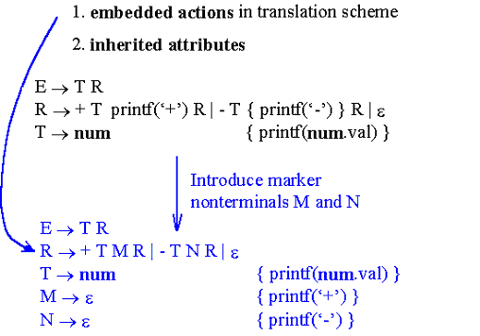
自底向上翻译
若已知翻译模式则应该进行变换将语义规则移至语法规则末尾:

Slide 47
在自底向上翻译中计算继承属性
语法规则 语义规则
D → T L L.in = T.type
T → int T.type = integer
T → real T.type = real
L → L₁ , id L₁.in = L.in
addtype(id.entry, L.in)
L → id addtype(id.entry, L.in)
举例： real id₁, id₂ , id₃

Slide 48
分析过程
STACK Input Action
$ real a,b,c$ SHIFT
$[real, lexval=‘real’] a,b,c$ REDUCE T → real modify type
$[T, type = ‘real’] a,b,c$ SHIFT
$[T, type = ‘real’] [id , lexval=‘a’] ,b,c$ REDUCE L → id requires L.in
$[T, type = ‘real’] [L, …] ,b,c$ SHIFT
$[T, type = ‘real’] [L, …], b,c$ SHIFT
$[T, type = ‘real’] [L, …], [id , lexval=‘b’] ,c$ REDUCE L → L, id requires L.in
$[T, type = ‘real’] [L, …], c$ SHIFT
$[T, type = ‘real’] [L, …], [id , lexval=‘c’] $ REDUCE L → L, id requires L.in

Slide 49
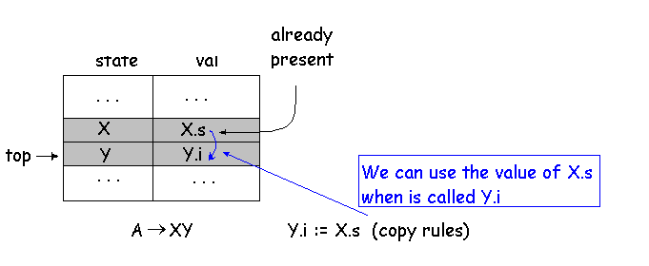
在自底向上语法分析中计算继承属性

Slide 50
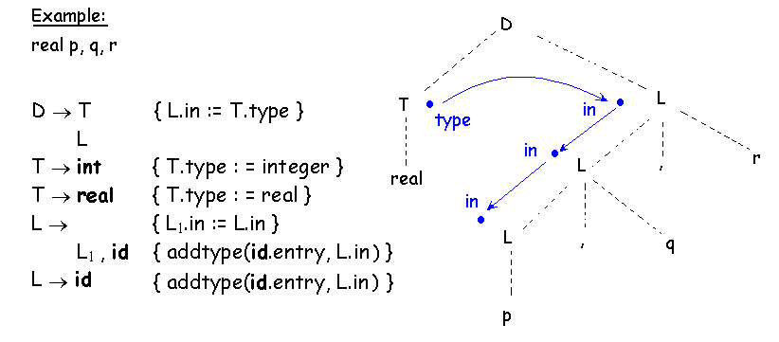
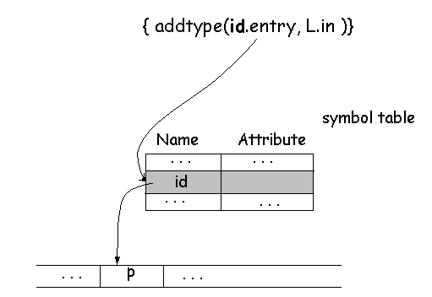

Slide 51
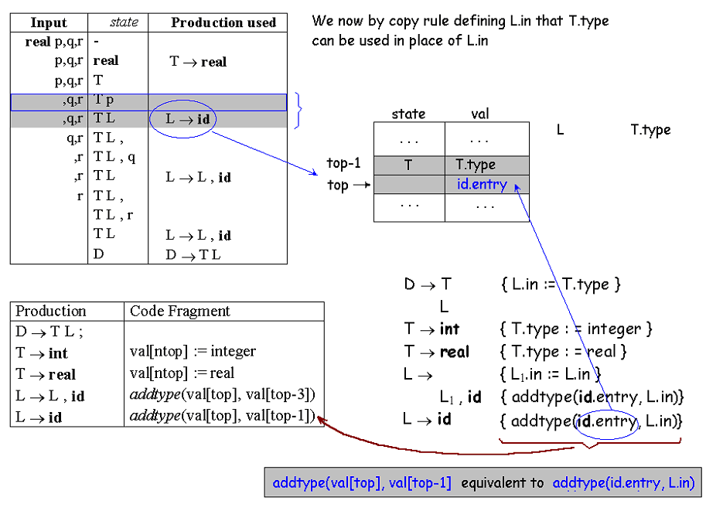

Slide 52
自底向上计算S属性定义
S-attributed Definition: Syntax-Directed Definition using only Synthesized attributes.
Stack of a LR(1) parser contains states.
Recall that each state corresponds to some grammar symbol (and many different states might correspond to the same grammar symbol)
Extend stack entries to include the attribute(s).
Modify stack contents as productions are selected.
State Val
X X.x
Y Y.y
Z Z.z
State Val
A A.a
A → XYZ
A.a = f(X.x,Y.y,Z.z)
=f(val[top-2],val[top-1],val[top])
New Top
Top

Slide 53
Example
PRODUCTION SEMANTIC RULE
L → E n print(E.val)
E → E₁ + T E.val = E₁.val + T.val
E → T E.val = T.val
T → T₁ * F T.val = T₁.val * F.val
T → F T.val = F.val
F → (E) F.val = E.val
F → digit F.val = digit .lexval
PRODUCTION CODE FRAGMENTt
L → E n print(val[top])
E → E₁ + T val[ntop] = val[top-2]+val[top]
E → T
T → T₁ * F val[ntop] = val[top-2]*val[top]
T → F
F → (E) val[ntop] = val[top-1]
F → digit
Example:
3*5+4n

Slide 54
自底向上计算继承属性
设计者要预测出需要的继承属性值在栈中的位置.
PRODUCTION SEMANTIC RULE
D → T L
T → int val[ntop] = integer
T → real val[ntop] = real
L → L₁ , id addtype(id.entry, val[top-3])
L → id addtype(id.entry, val[top-1])

